Slide 1
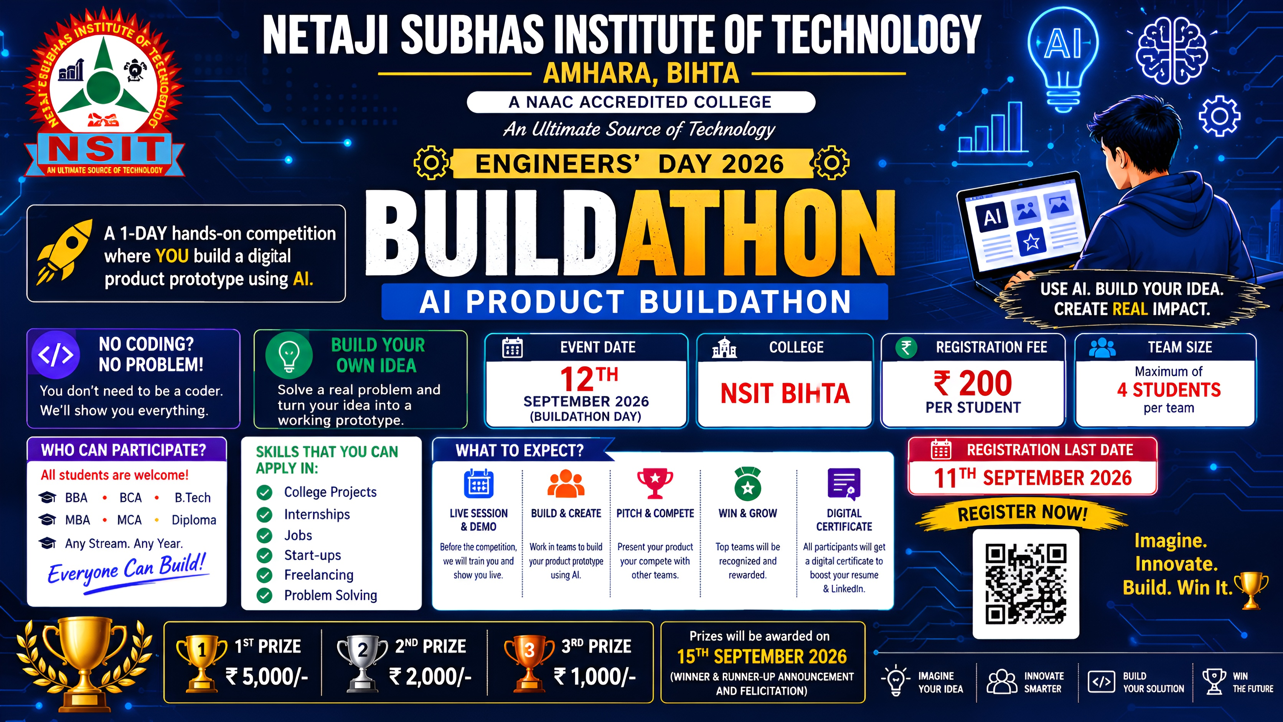

Slide 2

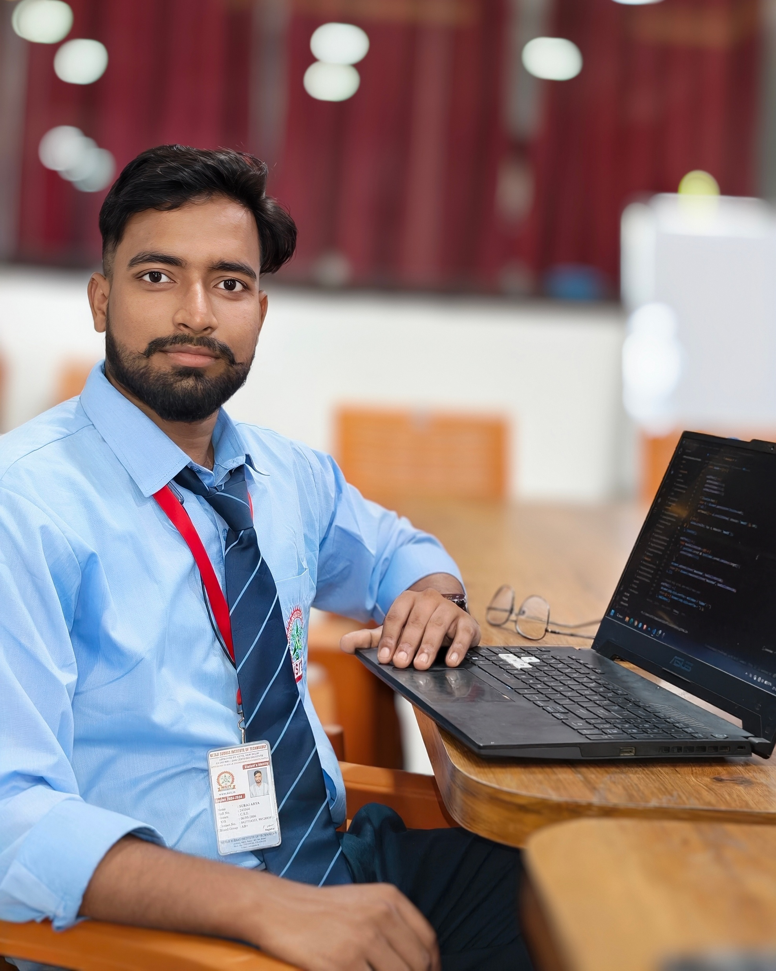



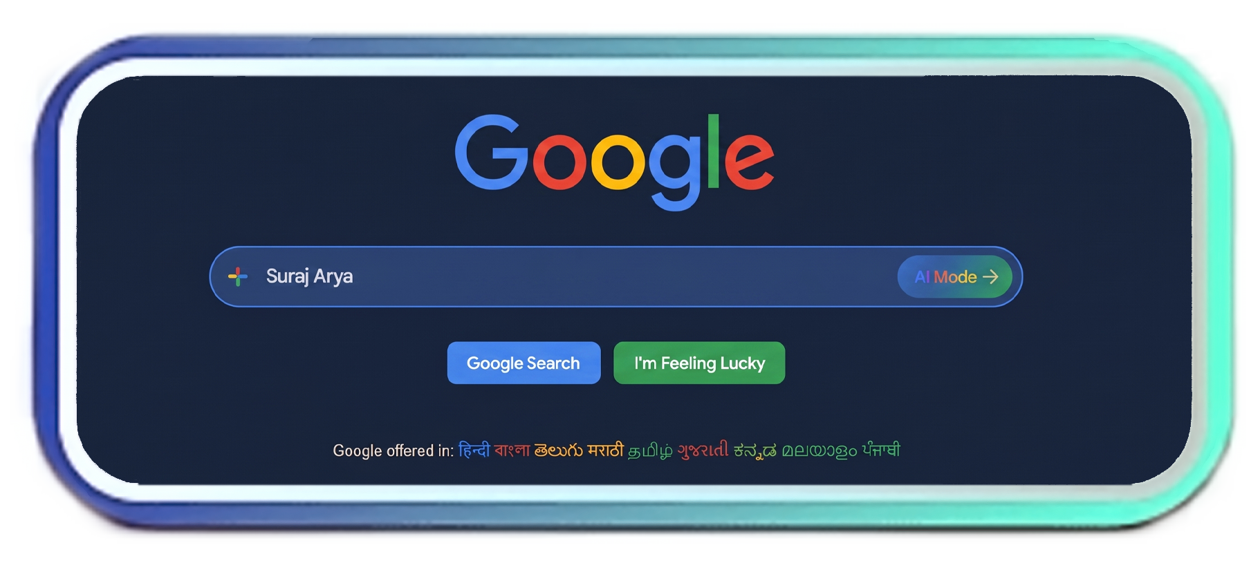
Meet Your Builder
Passionate about building scalable technology & AI systems
Suraj Arya
B.Tech CSE | 4th Semester • Diploma Holder
Software & AI enthusiast driven by experimentation. Focused on modern web ecosystems, agentic AI frameworks, and converting ideas into production-ready software.
CONNECT & NETWORK
LinkedIn GitHub Portfolio

Slide 3




ENGINEERS' DAY 2026 SPECIAL EDITION
BUILD WITH AI
From Idea to Working Project — Faster Than Ever

Slide 4

Great projects start with better questions
Use a simple framework before choosing a tool.
01
02
03
WHAT?
WHY?
HOW?
What are we solving?
Why does it matter?
How can technology help?
✓
CLARITY BEFORE CODE

Slide 5






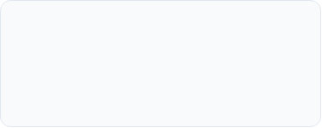
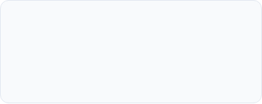
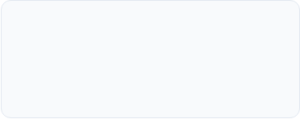
You Don't Need to Know Everything to Start
Shift mental models from syntax memorization to systemic orchestration.
Think Clearly
Explain Precisely
Iterate Continuously
Notes:
Explain that AI is not replacing the participant's thinking. It is reducing friction around drafting, explaining, debugging and iterating.

Slide 6



AI Doesn't Replace Thinking. It Amplifies It.
Supercharge your velocity from raw concept to ship-ready software.
HUMAN INTENT & LOGIC
AMPLIFIED
AI SPEED & EXECUTION
PRODUCTIVITY
System architecture, taste, edge cases, domain intuition & problem selection
Instant scaffolding, algorithmic synthesis, boilerplate & syntax conversion
Build Faster & Explore New Stacks
Experiment Fearlessly with Logic
Shift Focus from Syntax to Architecture

Slide 7





AI Ecosystem
One Idea. Many AI Tools.
Select the right intelligence engine for every stage of development.
THINK & REASON
BUILD & CODE
ChatGPT • Claude • Gemini
Antigravity • AI Studio • AI Agents
System design formulation, prompt engineering, edge-case analysis, and structural reasoning.
Autonomous development loops, boilerplate scaffolding, and live full-stack prototyping.
CREATE & MEDIA
DEPLOY & SERVE
Suno • Sarvam AI • Generative Art
Azure AI • Ollama • Copilot Studio
Audio synthesis, localized multilingual NLP, and custom multimodal asset generation.
Self-hosted local models, enterprise integrations, model serving, and serverless endpoints.

Slide 8

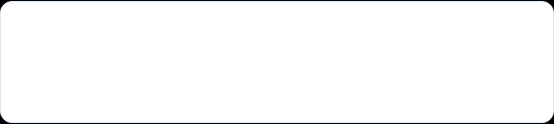


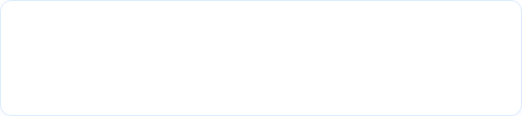
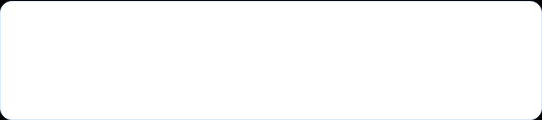

Featured Platform
Today's Building Partner: Antigravity
From Prompt → To Prototype → To Product
Build 10x Faster
AI-assisted coding and automated component scaffolding eliminate initial blank-canvas paralysis.
Rapid Iteration
Real-time hot-reloading with instant contextual fixes right within your interactive development view.
ANTIGRAVITY ACCELERATOR
Natural Language Specs Fullstack App
Zero Friction
Convert pure natural-language requirements directly into clean, modular, production-ready source code.
THINK • BUILD • DEPLOY

Slide 9

07 / GUIDED BUILDATHON ACTIVITY
Build one useful thing: a single-page portfolio
A small scope with a professional outcome.
BUILDATHON TASK 01
Personal
Portfolio
Suraj Arya
SA
B.Tech CSE • Projects • Skills • Socials
ABOUT
Your one-page digital identity: who you are, what you can build, and where people can find your work.
Developer
SKILLS
PROJECTS
EDUCATION
CONTACT
ABOUT
SKILLS
PROJECTS
SOCIALS
Think → Prompt → Build → Personalize → Share
NSIT BUILDATHON 2026
BUILD WITH AI
8

Slide 10
08 / GIT / GITHUB
From local project to collaborative work
Version control and public sharing make the buildathon output reusable.
GIT
GITHUB
DEPLOY
Track changes locally
Store • collaborate • showcase
Make the project accessible online
COMMIT
BRANCH
REPO
PROFILE
LIVE URL
SHARE
CODE
COMMIT
PUSH
DEPLOY
SHARE
Professional habit: save your work, document your work, publish your work.
NSIT BUILDATHON 2026
BUILD WITH AI
9

Slide 11







Deployment & Launch
Don't Just Build Projects. Put Them Online.
A project stored on localhost doesn't exist for the world. Ship it live on the web and get real users.
PRODUCTION CLOUD TARGETS
YOUR CALL TO ACTION
Vercel • Netlify • Render • AWS
THINK. BUILD. EXPERIMENT. DEPLOY.
Zero-configuration continuous deployment from your main GitHub branch with automatic SSL certificates and edge CDN distribution.
Netaji Subhas Institute of Technology • NSIT Buildathon 2026
NSIT BUILDATHON 2026 / 10
THINK • BUILD • DEPLOY

